Slide 1

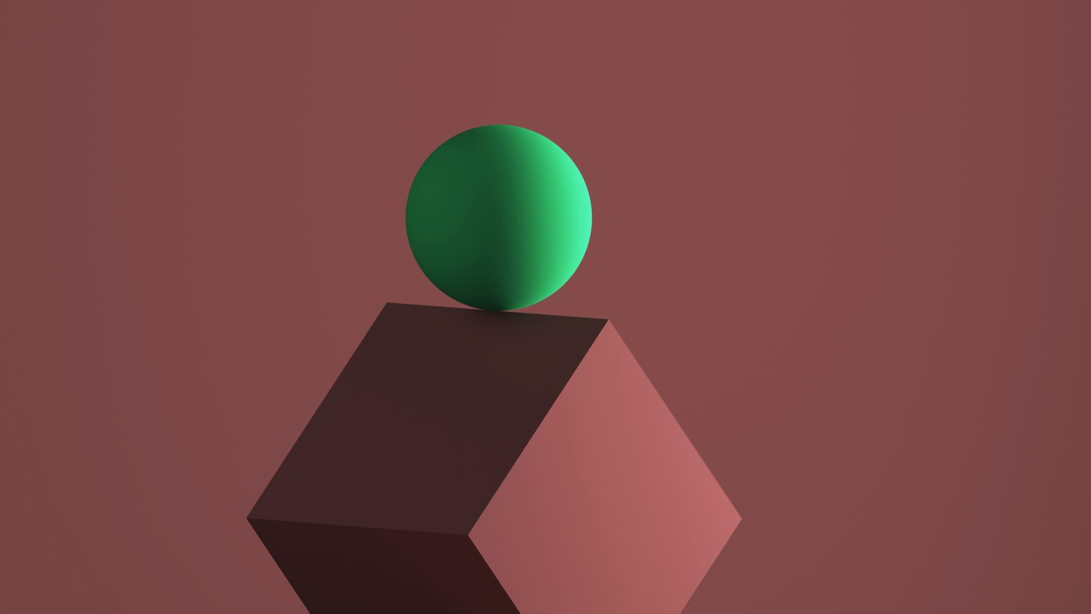

Image Filters with Generative Adversarial Networks by : ISHAVJOT SINGH OM BAKALE ANIRBAN gARAI
UNDER THE GUIDANCE OF MS.SARUTI GUPTA(TEACHING GUIDE)

Slide 2

Introduction
Many problems in image processing, computer graphics, and computer vision can be posed as “translating” an input image into a corresponding output image. Just as a concept may be expressed in either English or French, a scene may be rendered as an RGB image, a gradient field, an edge map, a semantic label map, etc.

Slide 3
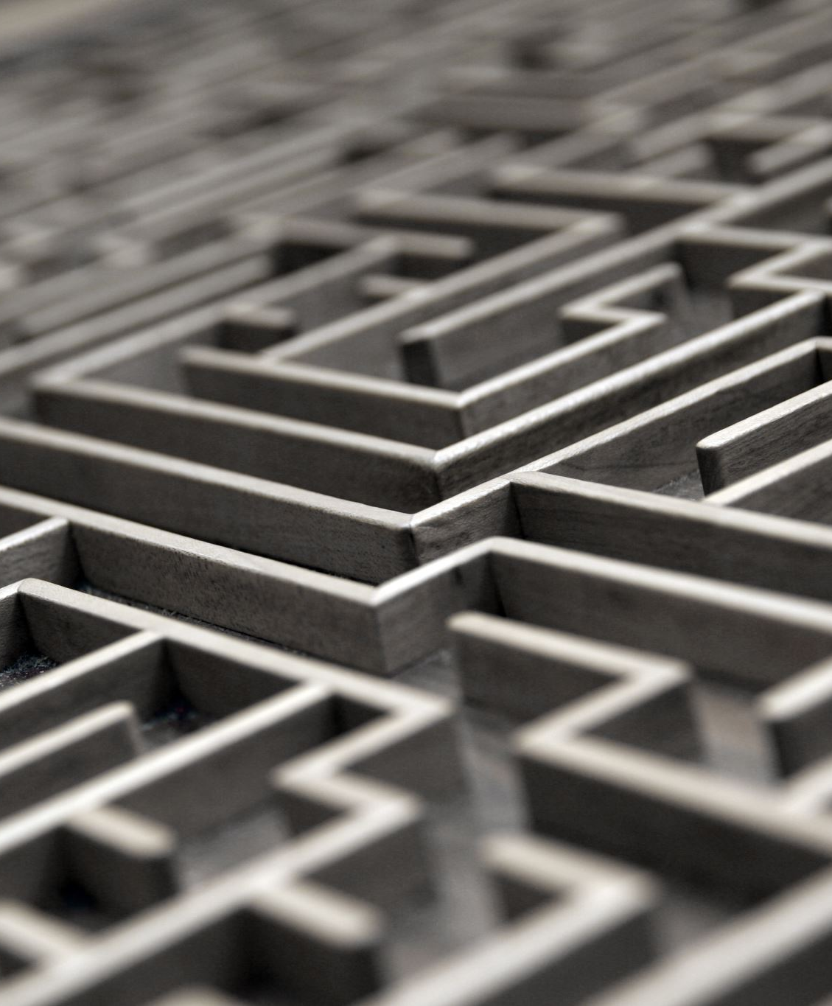
Why this approach?
Innovation: Unlike traditional image processing techniques, GANs offer a more advanced and flexible approach to generating realistic image filters.
Benefits: GANs can learn to mimic any distribution of data, providing unparalleled customization and creativity in filter design.
Challenges: GANs are computationally intensive and require careful tuning of parameters to achieve desired results.

Slide 4
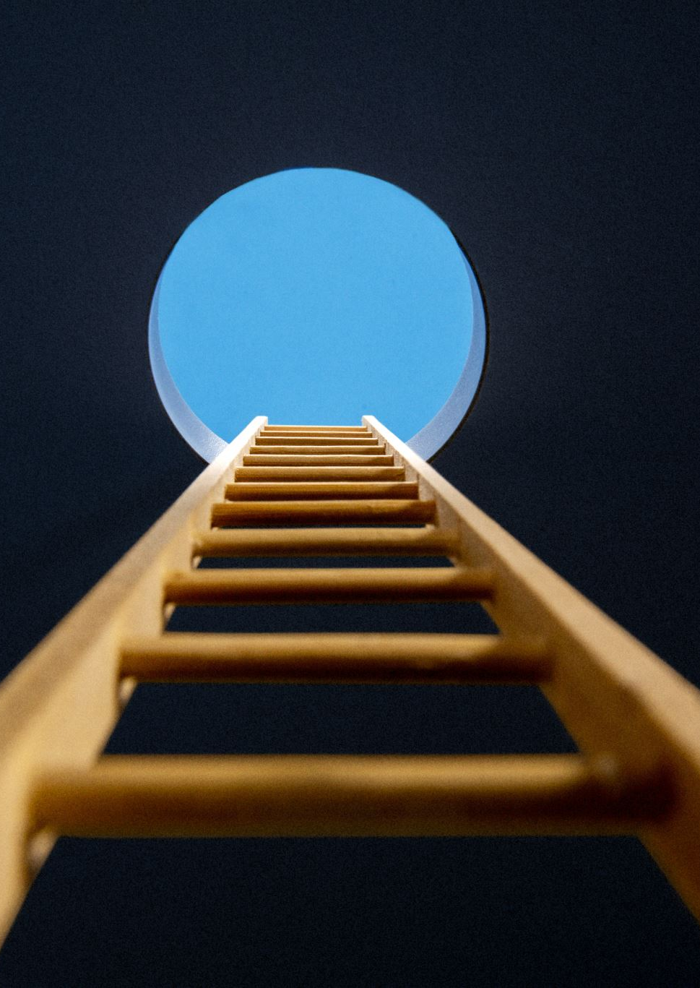
Understanding the Core Concept
StyleGAN (Style Generative Adversarial Network)
Purpose: Primarily used for generating highly realistic images. It offers control over the style of the generated images at multiple levels.
How it works: StyleGAN introduces a novel architecture that can control styles at different scales, from coarse to fine. It separates high-level attributes (e.g., pose, identity) from fine details (e.g., textures). This is achieved by feeding a style code into various points of the generator, affecting features at different scales.
Applications: Creating photorealistic faces, editing parts of images with high fidelity, and transferring styles from one image to another.

Slide 5
CycleGAN (Cyclic Generative Adversarial Network)
Purpose: Designed for image-to-image translation tasks where paired examples are not available. It can transform an image from one domain to another without needing a one-to-one mapping between the source and target domain.
How it works: CycleGAN uses two generator networks and two discriminator networks. The key idea is the introduction of a cycle consistency loss that ensures the original image can be reconstructed after a round-trip translation (source to target to source again). This helps in learning a meaningful translation without paired data.
Applications: Translating photographs into paintings, changing seasons in landscape photos, and transforming horses into zebras.

Slide 6


Pix2Pix (Pixel-to-Pixel)
Purpose: A framework for performing image-to-image translation tasks using paired images. It can map a source image to a target image.
How it works: Pix2Pix uses a conditional GAN where the generation of the output image is conditioned on an input image. It consists of a generator that translates the input image into the output image and a discriminator that tries to distinguish between the generated images and real images from the target domain. The training requires pairs of related images (e.g., a sketch and the corresponding colored image).
Applications: Turning sketches into photorealistic images, converting black and white photos to color, and changing daytime scenes to nighttime.

Slide 7
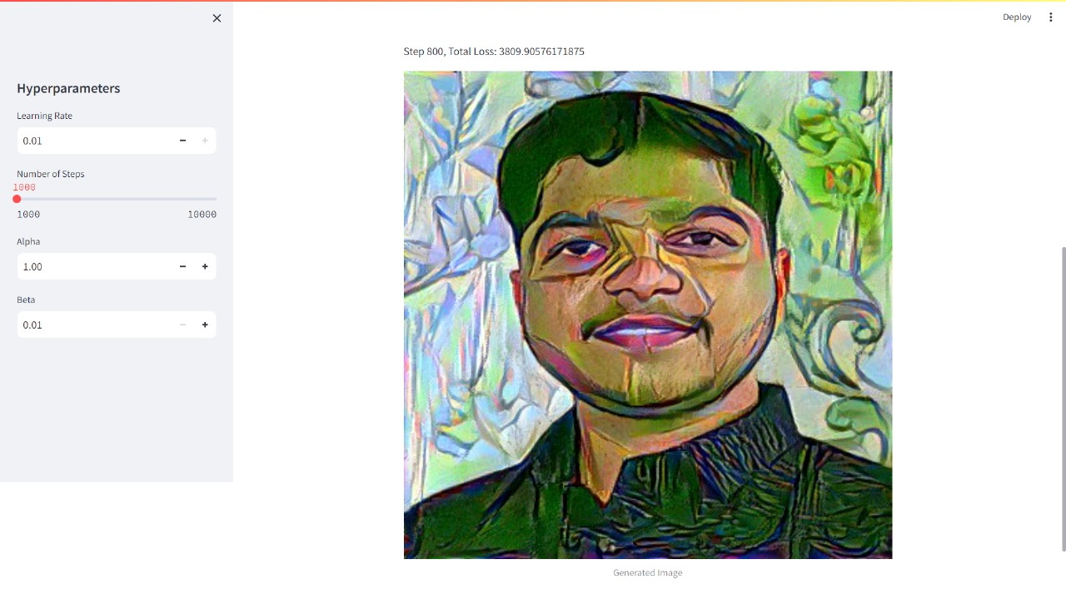
Output of GAN

Slide 8
Why use GAN filters?
GAN filters are used in various applications for their ability to generate high-quality, realistic images and translate images from one domain to another. Here are a few reasons why GAN filters are widely used:
Data Augmentation: They can generate new data instances for training models, especially useful in domains where data is scarce.
Image-to-Image Translation: They can translate images from one domain to another, useful in applications like photo enhancement, style transfer, and creating photorealistic images from sketches.

Slide 9
Project Roadmap
Phase 1: Initial Preparations - Setting up Python environment, understanding PyTorch and Streamlit basics.
Phase 2: Development - Designing and training the GAN models for image filtering.
Phase 3: Testing & Refinement - Evaluating filter effects, fine-tuning models.
Phase 4: Deployment & Future Work - Integrating with Streamlit for user interaction, planning for additional filter styles.

Slide 10
Deep Dive into Methodology
Approach: Utilizing PyTorch for model development due to its dynamic computation graph and efficient memory usage.
Implementation: Building a GAN with PyTorch where the generator creates images and the discriminator assesses them. Integrating the model with Streamlit for an interactive user interface.
Visuals: Flowcharts of GAN architecture, code snippets for PyTorch and Streamlit integration.

Slide 11
Challenges & Mitigation Strategies
Identify Challenges: Model convergence issues, ensuring realistic filter effects, user interface intuitiveness.
Strategies: Regularly monitoring loss functions, using pre-trained models as a starting point, iterative design approach for the Streamlit app.
Backup Plans: Utilizing cloud-based GPUs for training, community forums for troubleshooting.

Slide 12
Next Steps
Immediate Actions: Finalize the GAN model training, begin user testing of the Streamlit app.
Timeline: 1-2 months for initial deployment, ongoing updates based on user feedback and new advancements in GAN research.

Slide 13
Purpose: To provide an analysis of the performance and efficiency of your GAN-based image filters. Content Suggestions: Present benchmarks or comparative studies highlighting the performance of your GAN model versus traditional image filtering techniques.
Performance Analysis

Slide 14
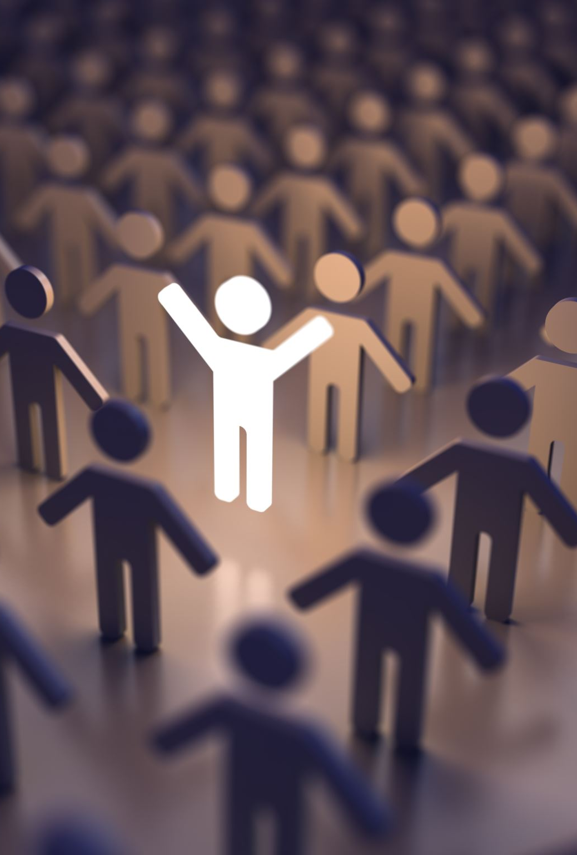
Community and Open Source Contributions
Purpose: To discuss the role of the community and open-source contributions in advancing GAN-based image filter technologies.
Content Suggestions:
Mention notable open-source projects or libraries related to GANs and image filtering in Python and PyTorch.
Highlight how contributions from the community have propelled advancements in this field.
Encourage participation and contribution, providing links to repositories or forums where attendees can engage.

Slide 15
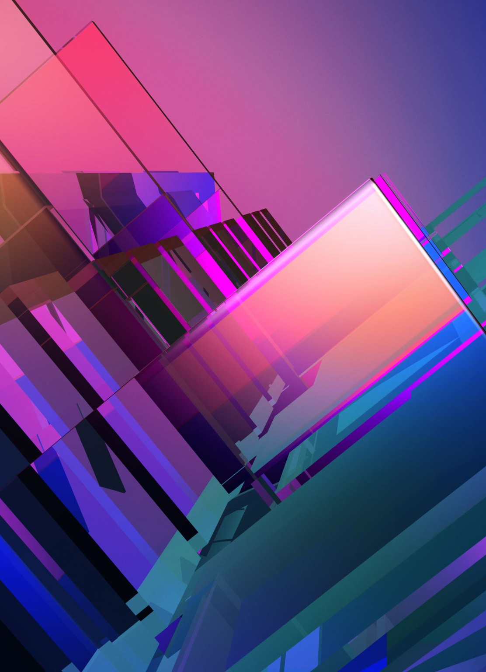
CONCLUSION
Future Directions:
Look ahead to the potential future applications of GAN-based image filters, including virtual reality, augmented reality, and advanced photo editing.
Mention ongoing research or development efforts to enhance GAN models, improve efficiency, and expand the range of artistic styles and effects achievable through AI.

Slide 16
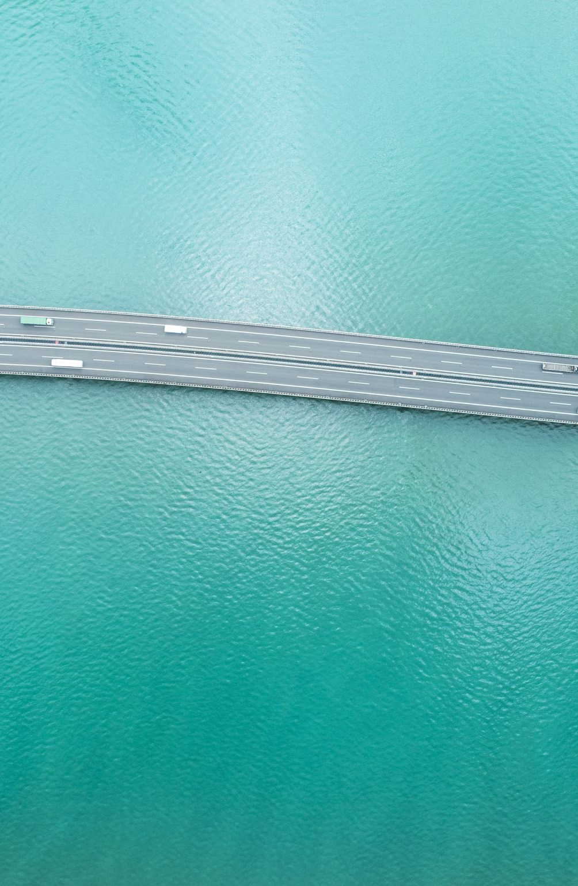
THANK YOU

